Slide 1
BSc I YEAR
CHEM 101
SECTION D
ALKYNES

Slide 2
ALKYNES
Acyclic unsaturated hydrocarbons containing a triple bond are called alkynes or acetylenes. Their general fommla is CnH 2 n _ 2 where n = 2, 3, 4 ... ... etc .
Common names
In the common system, the first member of the series is called acetylene.
IUPAC names.
Alkane-ane + yne = Alkyne.

Slide 3

METHODS OF PREPARATION OF ALKYNES
1. By the action of water on calcium carbide
Ethyne (acetylene) is prepared in the laboratory as well as on a commercial scale by the action of water on calcium carbide.

Slide 4
ALKYNES
. Synthesis of higher alkynes from acetylene.
Acetylene is first treated with sodium metal at 475 K or with sodamide in liquid ammonia at 196 K to form sodium acetylide. This upon treatment with primary alkyl halides undergoes Si reaction to give higher alkynes. For example

Slide 5
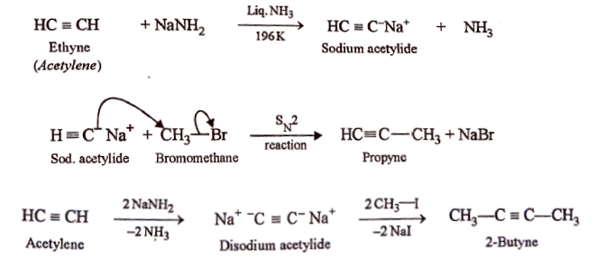
LOWER TO HIGHER ALKYNES

Slide 6
By dehydrohalogenation of dihaloalkanes.
. Alkynes are prepared by dehydrohalogenation of vicinal-dihaloalkanes on heating them with an alcoholic solution of potassium hydroxide.

Slide 7
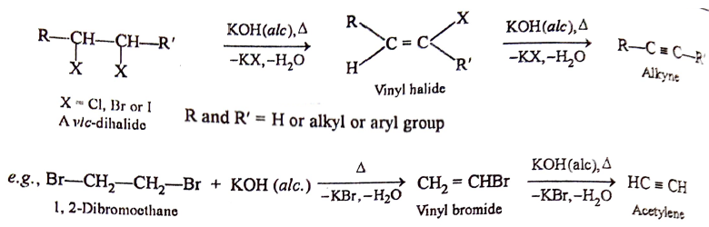
DEHYDROHALOGENATION

Slide 8
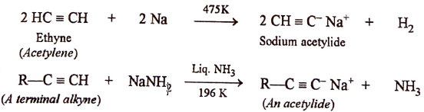
CHEMICAL REACTION OF ALKYNES
. Formation of alkali metal acetylides.
Ethyne and other terminal alkynes (or 1-alkynes) react with strong bases such as sodium metal at 475 K or sodamide in liquid ammonia at 196 K to form sodium acetylides with evolution of H₂ or NH₃ gas

Slide 9
. Formation of heavy metal acetylides
Acetylenic hydrogens of alkynes can also be replaced by heavy metal ions such as Ag⁺ and Cu⁺ ions. For example, when treated with arnmoniacal silver nitrate solution (Tollens reagent), alkynes form white precipitate of silver acetylides.

Slide 10
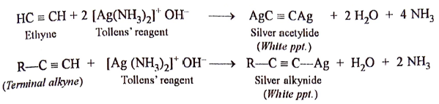
Heavy metal acetylide

Slide 11
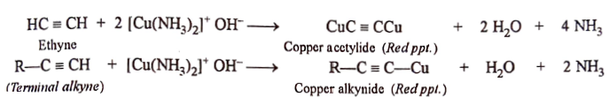
HEAVY METAL ACETYLIDE

